Slide 1
FAANG Stock Price Prediction using LSTM
Jahnavi Ashok
Sreeram Avasarala

Slide 2
Agenda
Problem Description
Motivation
Goal
Dataset & Preprocessing
Feature Engineering
Methodology
Results
Investment Strategy & Insights

Slide 3
Problem description
Stock markets are volatile.
Traditional models (ARIMA, SVM) often fail to capture non-linear and sequential dependencies in financial time series.
A stock’s price behavior is not isolated.

Slide 4
Motivation
Most models rely only on historical price data and ignore interdependencies between stocks.
FAANG stocks exhibit correlated behavior, suggesting shared patterns can be learned.
A unified model can capture both individual stock behavior and cross-stock influences.

Slide 5
Goal
To forecast 30-day future stock prices for FAANG companies.
Recommend the stock with the highest expected return.

Slide 6
Dataset and preprocessing
Source: Kaggle FAANG dataset (2005–2024)
Stocks: Meta, Amazon, Apple, Netflix, Google
Features collected:
Open, High, Low, Close, Volume, EPS, Market Cap, P/E ratio, Revenue Growth, Beta
Preprocessing steps:
Filtered for common dates across all five stocks
Handled null values and scaled numeric features using MinMaxScaler

Slide 7
Feature Engineering
Daily Return – Measures day-to-day percentage change
10-Day Moving Average – Smooths short-term fluctuations
10-Day Rolling Volatility – Captures recent risk levels

Slide 8
Methodology
Phase 1 — Individual LSTM Models
Trained separate LSTM models for each FAANG stock
Input: 60-day sequences
Output: 15-day ahead price prediction
Helped understand individual stock patterns
Phase 2 — Unified Multi-Stock LSTM Model
Combined all FAANG data into a single dataset
Input: 60-day sequences of both technical and fundamental features
Output: 30-day ahead price prediction
Captured cross-stock patterns and dependencies
Design Choices
Dropout for regularization
Adam optimizer
Manual tuning of hyperparameters

Slide 9
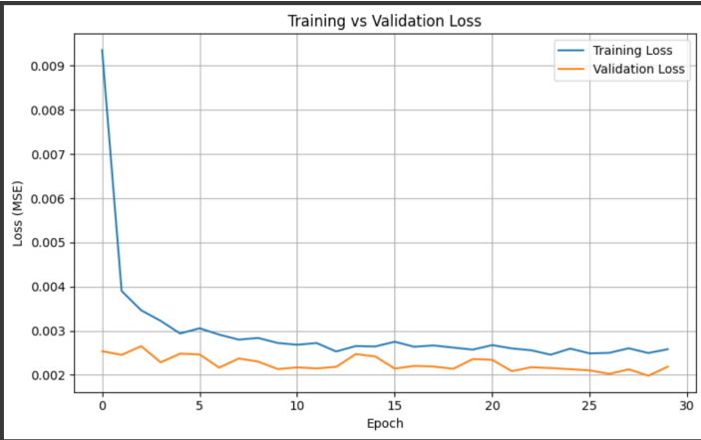
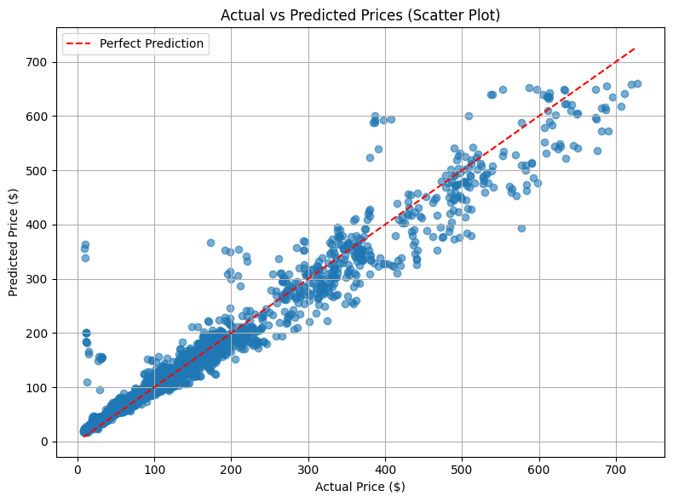
Results
Best hyper parameters: Units=32, Dropout=0.1, Batch Size=64
RMSE: On average, predictions deviate from actual values by about $30.
MAE: The average absolute error is under $17, indicating low bias.
R²: 94.87% of the variation in actual stock prices can be predicted using the features your model has learned from.

Slide 10
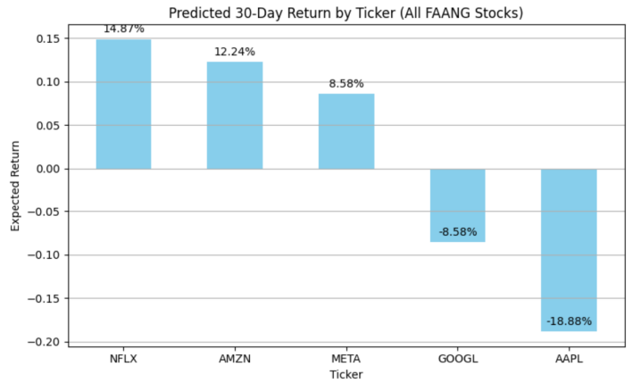
Investment Strategy
Model recommended Netflix (NFLX) with an expected 30-day return of 14.87%
The evaluation period is October 18, 2024 – November 18, 2024
When compared with actual prices using yfinance, we observed 11.86% return.

Slide 11
Thank you

